Slide 1
Elucidation of Coherent Gene Groups in Autism Spectrum Disorder
Benjamin Pham
CHEM280

Slide 2
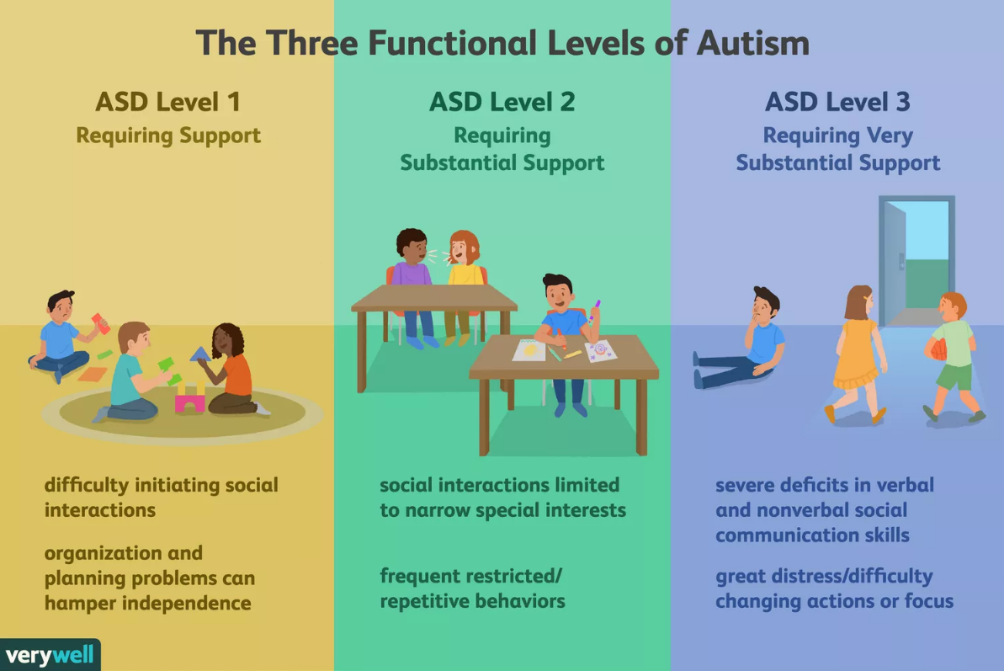
Background
Autism Spectrum Disorder (ASD) is a developmental disease affecting mainly cognitive function
Coherent-gene groups expression can change at different developmental stages
Can specific gene groups be determined?
What is the regulatory system behind it?

Slide 3
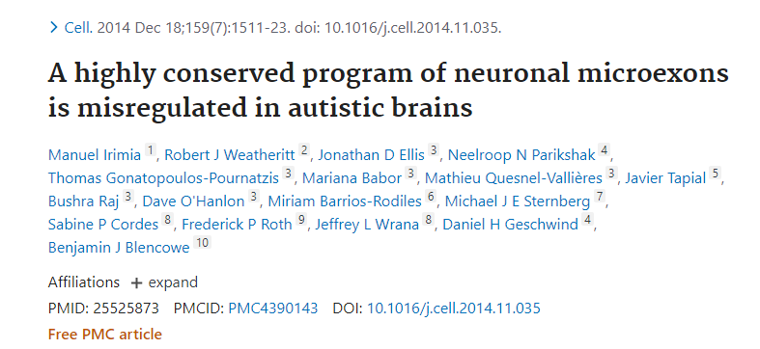
The Data: GSE64018
Raw Count data of post-mortum brain tissue between ASD vs control samples
12 ASD samples, 12 control samples
Minimum age: 15, Maximum Age: ~60

Slide 4
Workflow
Co-Expression Gene Network Clustering (WCGNA)
Differential Expression (DE-Seq2)
Motif Enrichment (MEME-Suite)
Transcription Factor Hierarchical Model
Pathway Analysis (DAVID)
Gene Ontology (PANTHER)

Slide 5
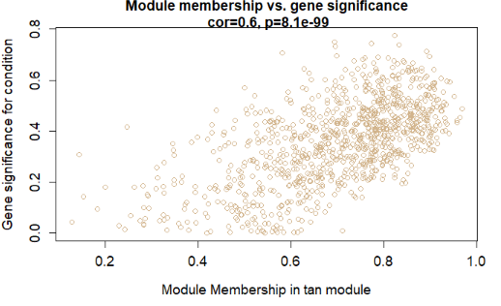
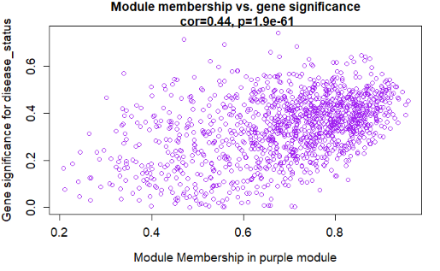
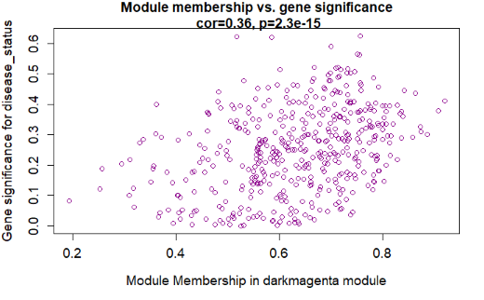
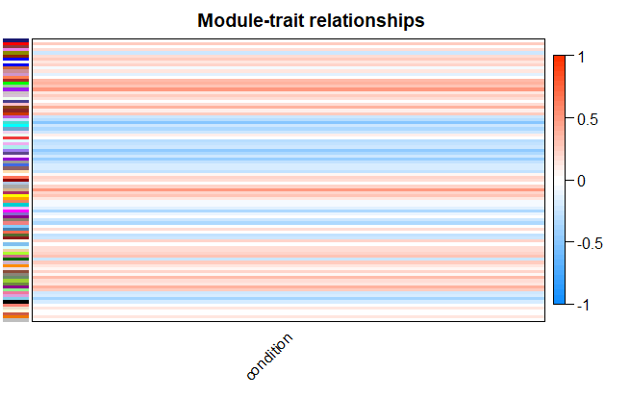
Results - WCGNA

Slide 6
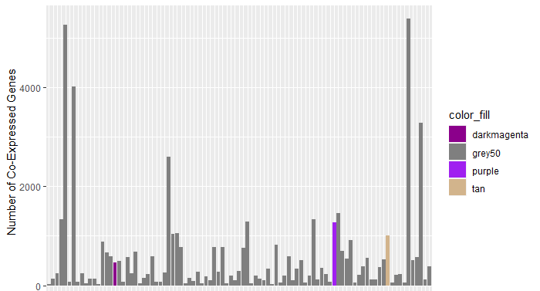
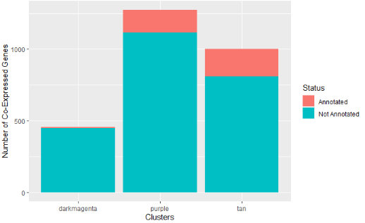
Results - WCGNA
159/1274
189/1000
8/455
1274
1000
455
Clusters n = 93

Slide 7
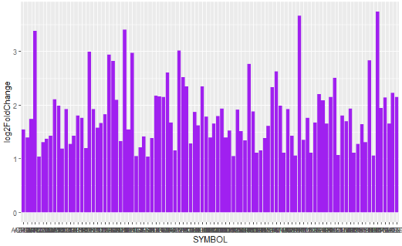
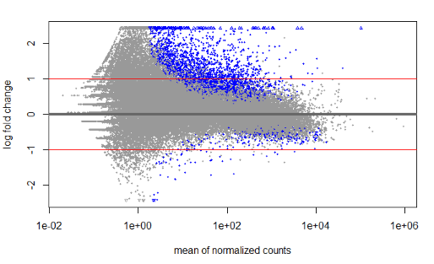
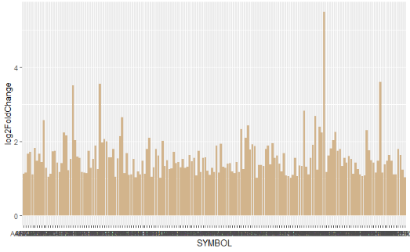
Results – DESeq2
97/159
63,152 genes -> 53,521 QC genes -> 885 DE genes -> 660 annotated DE genes
171/189

Slide 8
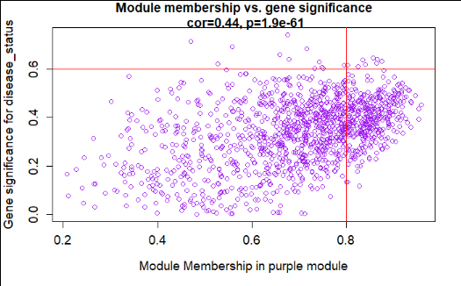
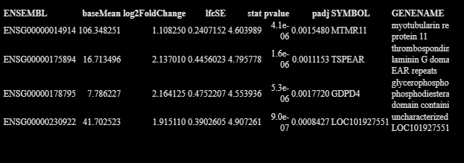
Results – Hub Gene Candidates for Purple Module in Differential Expression Results
Cluster | SYMBOL | GENENAME
tan | MSN | moesin
purple | NA | NA
darkmagenta | NA | NA

Slide 9
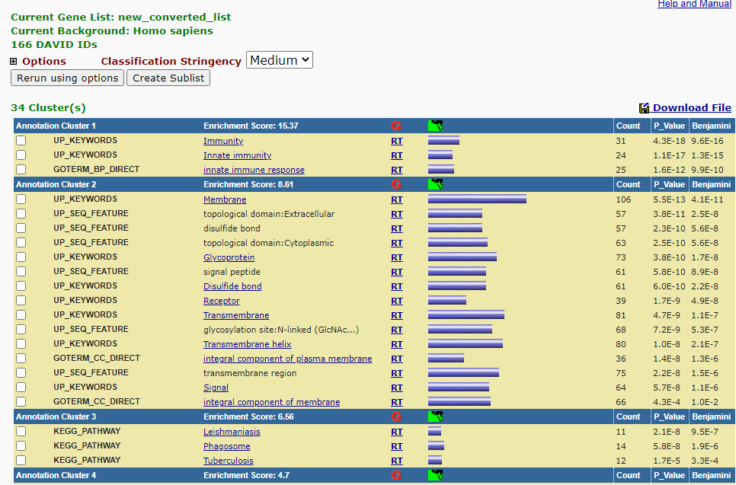
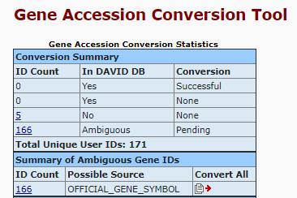
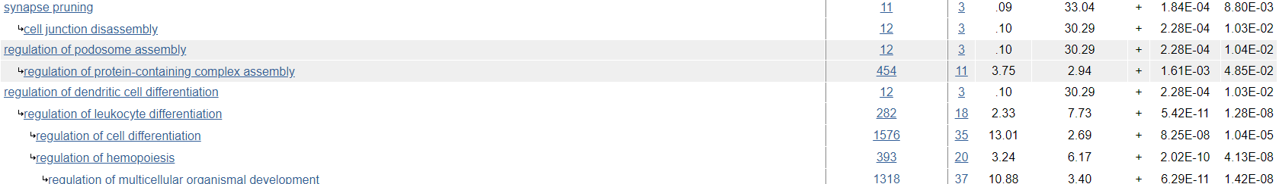
Results – Tan Cluster Pathway Analysis and GO

Slide 10
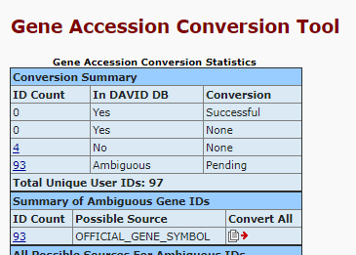
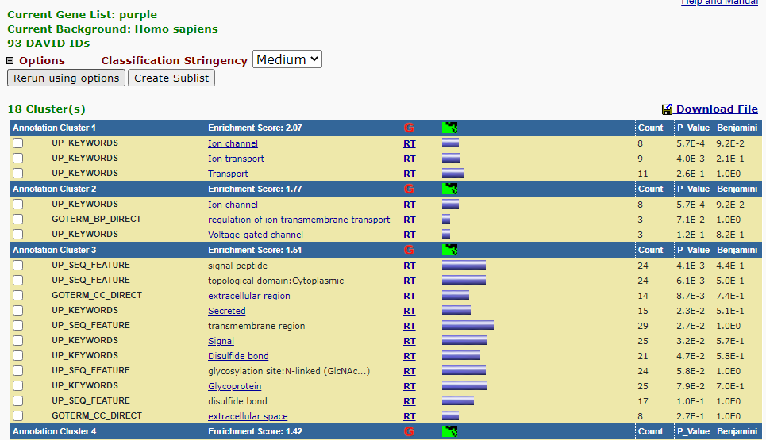
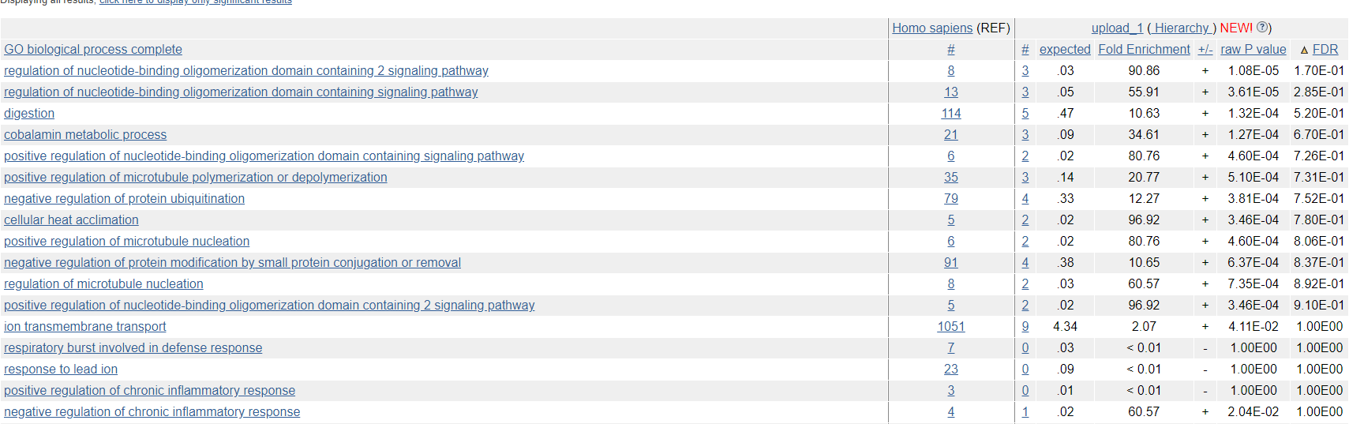
Results – Purple Cluster Pathway Analysis and GO

Slide 11
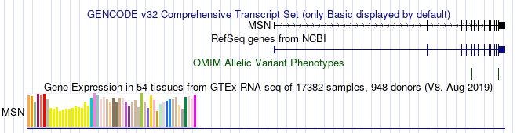
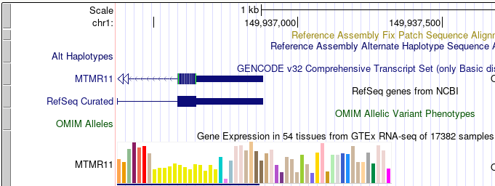
Results – Promoter Sequence of Hub Genes

Slide 12
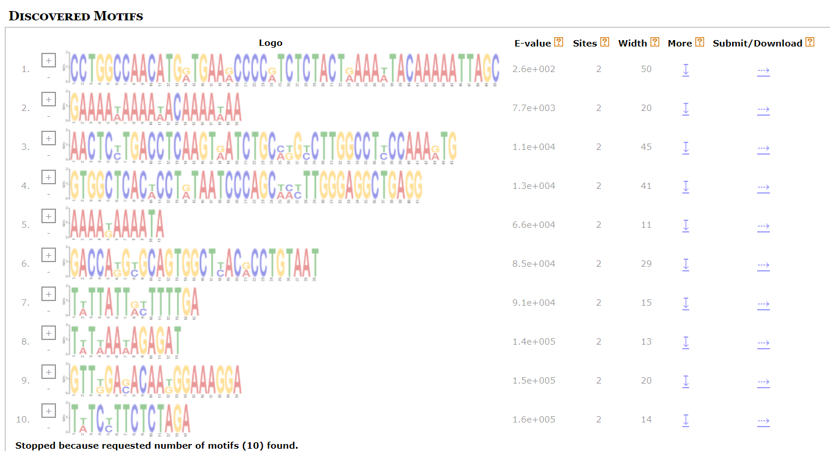
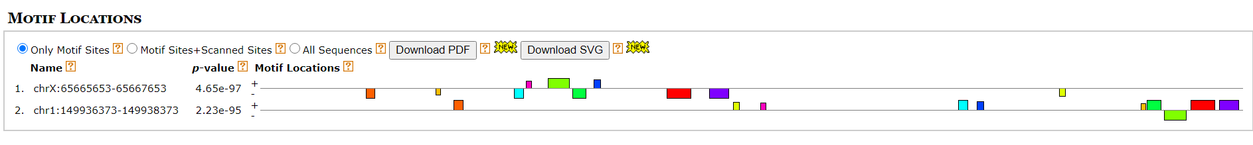
Results - MEME

Slide 13
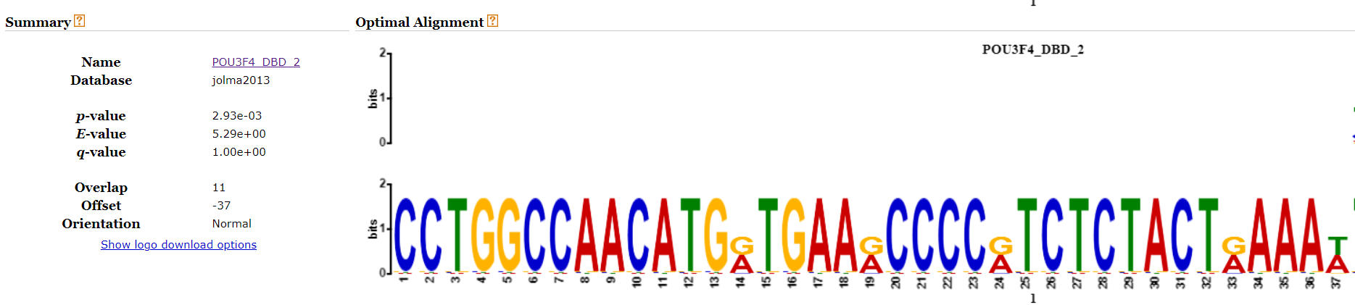
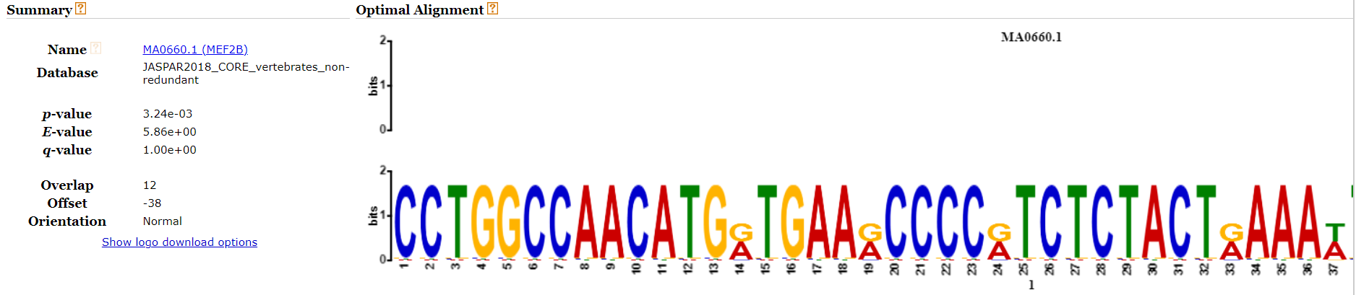
Results - TOMTOM

Slide 14
Discussion and Future Directions
Examined clusters were marginally related to ASD or brain
At best, these genes could be novel, at worst – there’s too little genes in these analysis
Too many genes were removed from the cluster due to annotation or perhaps too many clusters
Need to determine incidence of known ASD risk genes in clusters (ie: SFARI)
ASD Samples are hard to access! But if more are found, can be used to determine differences between development stages

Slide 15
Conclusion
Clusters show somewhat that the co-expressed genes pertain to brain function
Common Transcription Factor binding sites show that the two clusters could work together or could be regulated by the same system
A Transcription Factor Hierarchical System can be made

